Slide 1
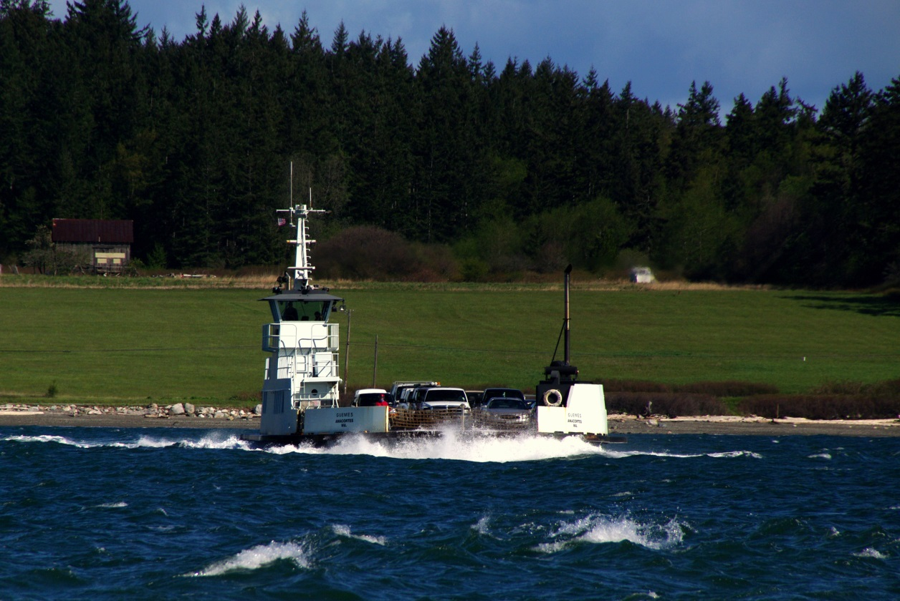
Guemes Island Community Meeting
Skagit County Ferry Replacement Project
County Commissioners
Public Works
Glosten
August 29th, 5:30 p.m. Guemes Island Community Center 7549 Guemes Island Road

Slide 2
AGENDA
5:30 – 5:40 p.m. Introductions & Opening Remarks
Skagit County Commissioners
Ron Wesen, Chair, District 1
Ken Dahlstedt, District 2
Lisa Janicki, District 3
Glosten
Dave Larsen, P.E., Principal-In-Charge
Public Works
Dan Berentson, Director
Paul Randall-Grutter, P.E., County Engineer
Jim Mickel, Finance Manager
Forrest Jones, Grants and Programs Manager
Rachel Rowe, Captain, Ferry Operations Division Manager
Guemes Island Ferry Committee
Steve Orsini, Chair
5:40 – 6:40 p.m. Presentation – Ferry Replacement Project Update
Project Status - Phase 1 Scope of Work
Project Funding - County Ferry Capital Improvement Program
Community and Stakeholder Engagement
6:40 – 7:30 p.m. Questions and Comments
7:30 p.m. Adjournment & Clean-Up

Slide 3
Project Status – Summary
Replace the M/V GUEMES
Age: 38
Annual Maintenance Cost: $700,000+
Estimated Re-Power Cost: $3.5 million+
Skagit County’s vision: a zero-emissions, all-electric vessel
Reduce greenhouse gas emissions
Benefit local community & global environment
Design Considerations
Vessel
Shore Side Facilities
Operational Profile
ADA Guidelines
Safety & Reliability
Level of Service
Future Growth
Existing Docks & Terminals
Maneuverability
Regulatory – USCG
Environmental Impacts
Infrastructure Upgrades
Safety & Reliability
Passenger Access & ADA
Vehicle Staging
Parking
Environmental (Permitting)
Charging Stations (if all-electric)
Notes:
Skagit County has determined an immediate need to replace the M/V GUEMES. If not, the vessel will require a major re-fit/re-power that is estimated at $3.5 million, plus. The 14-Year Ferry Capital Improvement Plan currently has this re-fit and re-power planned for 2022.
In a study conducted by Elliott Bay Design Group in 2013, the engineering firm said, “While the overall condition of the vessel is fair, it is recommended that the M/V GUEMES not be operated for another ten years without a major overhaul. This is due to the advanced age of the vessel and high cost of extending the operation of the vessel beyond its economic useful life of 30-40 years.” A major overhaul could take the vessel out of service for 6 months to 1 year, according to the study. The report goes on to say, “…given its age, it is recommended that the life of the vessel not be extended beyond for another 15-18 years. As a vessel reaches 50 years of age, it becomes economically impractical to preserve the vessel. At such an age, many systems must be replaced, salt-water corrosion to the hull makes maintaining the vessel expensive, and the vessel may no longer be capable of meeting the service needs of the island.”
The Skagit County Commissioners would like to replace the aging ferry with an all-electric vessel.
There are many design considerations to factor in when selecting a propulsion system, whether its geared diesel, hybrid or all-electric. Please note, these are in no specific order.
Vessel:
Operational Profile – Where and how the vessel will be operated. Includes things like intended class (if applicable), route & route conditions, speed requirements, turn-around times, environmental conditions, hotel requirements, crewing, etc.
ADA Guidelines – The new vessel will comply with the ADA guidelines for passenger vessels.
Safety & Reliability – These are top priorities.
Level of Service – Traffic flow, trips/hour, wait times, efficiency, ticketing, how we move people, etc.
Future Growth – We need to make sure we do not undersize the ferry and it cannot serve for 40 years.
Existing Docks & Terminals – The new ferry must fit within the existing breakwater and dolphins.
Maneuverability – We must maintain or improve maneuverability. The new vessel will likely have z-drives.
Regulatory – US Coast Guard, Class Societies, like ABS, Lloyd's, DNV/GL or other, Fire Department.
Environmental – SEPA or other permitting
Shore Side Facilities:
Infrastructure Upgrades – Improve safety & reliability, passenger access & ADA, staging areas, etc.
Parking – Again, this would be an example of an infrastructure upgrade.
Environmental – Permitting; depending on the scope of upgrades to docks, permits could be required.
Charging Stations – Would be required if all-electric propulsion is selected.

Slide 4
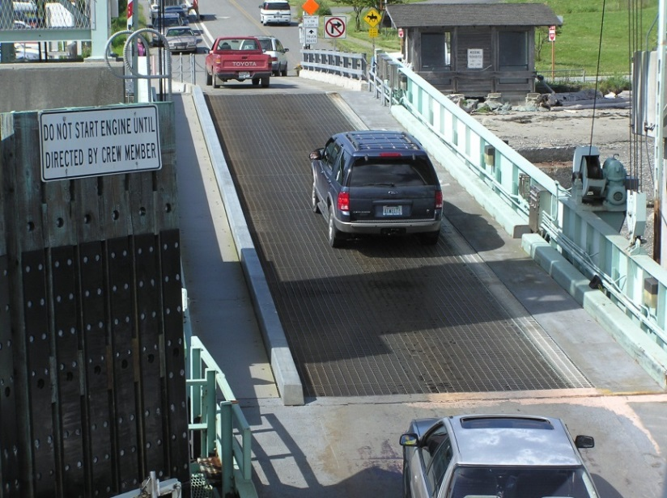
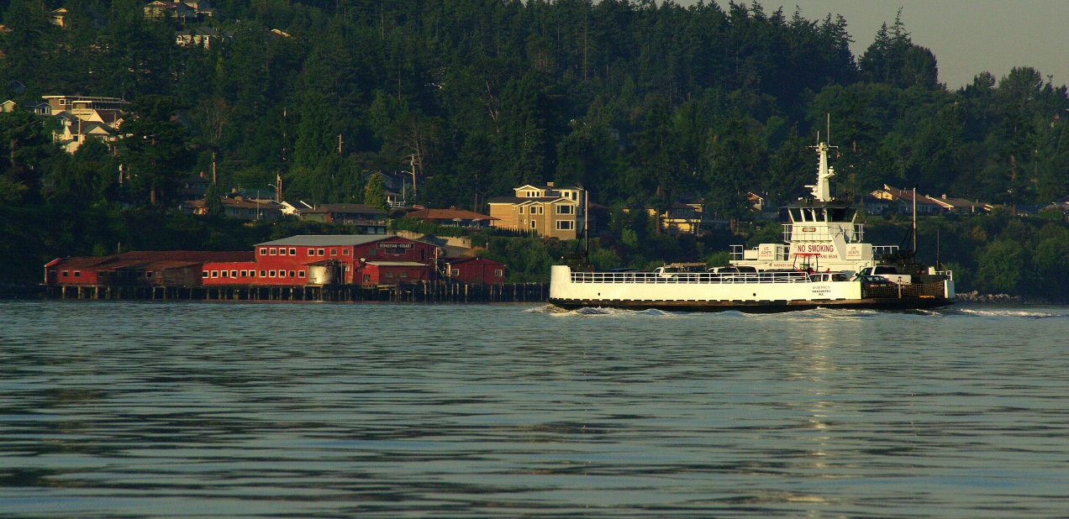
Project Status :
A Naval Architecture Firm Has Been Hired – Glosten, Seattle
Skagit County issued a Request for Qualifications (RFQ)
Naval architecture services
Design a replacement vessel
August 7 – Contract approved by Board of County Commissioners
Phase 1 – Analysis & early design
August 14 – County’s project kick-off meeting with Glosten
Concept design is underway
Notes:
Early this year, Skagit County issued a RFQ for Naval Architecture & Marine Engineering Services for the design of a replacement vessel.
A total of 6 proposals were received. The top 3 firms were interviewed – Glosten, Elliott Bay Design Group and Art Anderson Associates.
The Guemes Island Ferry Committee was represented on the review and selection team; member Tom Fouts assisted Skagit County in the process.
Skagit County also posted an ad in the paper for a retired naval architect to serve on the review and selection team. Jon Hodgdon, of Anacortes, volunteered.
A big thank you to Jon, Tom and the Ferry Committee for their involvement. They did a great job and spent a lot of time working with us.
A contract was approved by the Board of Skagit County Commissioners on August 7th and we’ll talk a little bit more about the complete scope of work a little later. And we had our kick-off meeting with Glosten on August 14th. The Ferry Committee was also represented at the kick-off meeting as member Tom Fouts attended that meeting as well.
Glosten is here tonight, and they have a short presentation. We are very excited to be working with this accomplished and well-qualified firm. Introduce Dave Larsen, P.E., Principal-In-Charge for the project. Dave will go through the Glosten slides.

Slide 5
Project status - Phase 1 Scope of Work
Contract Term: 1 Year
Contract Amount: $513,742.35
Phase 1 Tasks
Design studies
Concept design
Preliminary design
Funding support
Phase 1 Deliverables
Concept design report
Preliminary design report
General arrangement drawings
Engineer’s cost estimate
Concept & 30% Design Completion: December 31, 2017
Notes:
Difference between concept design and preliminary design:
Concept design – the process of determining all of the things the vessel will need to do and be; design requirements like how many cars, how many people, speed & maneuverability, terminal interface, environmental, noise, reliability, maintainability, regulatory requirements, propulsion options, life cycle costs, etc. Concept sketches will define how the vessel will look and feel. Basic arrangements, weights, powering, stability, etc. are determined.
Preliminary design – Builds upon the chosen concept design. Development of the propulsion system, structure, weights, mechanical & electrical systems. 3D modeling will commence and renderings of the vessel’s exterior will be developed to assist with funding requests.

Slide 6
Estimated Timeline:
Design Studies
Concept Design Report
Preliminary Design
Apply for Funding
Funding Approved
Bidding Process
Shipyard Notice to Proceed
Construction Starts
2017
2018
2019
2020
Regulatory Reviews
Contract Design
Funding Requests
Construction
Delivery
Crew Training
Vessel Enters Service
Notes:
Difference between preliminary design and contract design:
Preliminary design (see previous slide’s notes page for more information) has different review stages; typically 3 stages to include 30% design, 60% design and 90% design. Once these design stages are complete, the agency will have a contract design that can be used to solicit bids for construction.

Slide 7
Project Funding
Year______________ Agency/Program___________________________________________
2014 Puget Sound Clean Air Agency
2015 Maritime Administration (MARAD)
2015 Build America – Transportation Investment Center
2016 Clean Energy Fund 2
2016 Federal Transit Administration (FTA)
2017 Economic Development Grant
2017 EPA – Diesel Emissions Reduction Act (DERA) Program
2017 Surface Transportation Grant
2017 Volkswagen Settlement – Apply
2017 Infrastructure for Rebuilding America (INFRA) – Apply
2017 Public Works Trust Fund – Apply if funded
2017 County Ferry Capital Improvement Program (CFCIP) – Apply
Notes:
These funding sources with a red “x” next to them indicate funding for which Skagit County has applied, and been a) determined not eligible, or b) turned down. The remaining funding sources remain an option and Skagit County intends to apply as the programs become available.
Skagit County will continue to pursue all funding sources for this project. Some of these programs become available each year, or more than once, so there will be future opportunities to apply.
The intent last year at this time, was to apply for a TIGER grant in 2017; however, the grant has not been available in 2017. And, the Transportation-House spending bill for fiscal year 2018 did not include funding for the TIGER grant.

Slide 8
County Ferry Capital Improvement Program (CFCIP)
Administered by CRAB (County Road Administration Board) - WAC 136-400
Eligible Counties
Pierce, Skagit, Wahkiakum & Whatcom
Eligible Projects
Purchase of new vessels, vessel/facility refurbishment/replacement/improvement
Applications Due
December 31, 2017
Maximum Award
$10 Million, ferry district requirement
Allocation is $500,000/year over a 20-year period
Project Cost-Sharing
County Ferry District | County / Other | CFCIP
Greater than 30% | 0% | Up to 70%
Greater than 5%, but less than or equal to 30% | 20% minimum | Less than or equal to 50%
Less than or equal to 5% | 70% minimum | Less than or equal to 30%
No District | 70% minimum | Less than or equal to 30%
Notes:
The County Ferry Capital Improvement Program (CFCIP) grant is administered by the County Road Administration Board (CRAB). CRAB was created by the legislature in 1965 to provide statutory oversight of Washington’s 39 county road departments. The agency is funded from a portion of the counties’ fuel tax that is withheld for state supervision, and a small portion of the two grant programs that it administers. The agency is governed by a nine-member board which meets quarterly and is comprised of 6 county commissioners/council-members and 3 county engineers. The Board is appointed by the Board of Directors of the Washington State Association of Counties.”
These are the basic grant requirements. More information can be obtained by reading WAC 136-400.
CFCIP details:
Created in 1991; specifically to assist Counties operating car ferries
Funding is available once every 4 years.
Requires applicants to seek every other possible source of funding, including the Public Works Trust Fund.
Eligible counties are only those that operate car ferries.
Pierce County has utilized this funding and they are still receiving reimbursement for their project. Therefore, they will be ineligible for the program now.
Whatcom County received approval through this program about 10 years ago for a new vessel build, but they decided not move forward.
Therefore, Whatcom County, Wahkiakum County and Skagit County could submit applications for projects this year.
Eligible project include:
Purchase of new vessels
Major vessel refurbishment
Facility refurbishment and replacement
Installation of items that substantially improve ferry facilities or operations
Construction of infrastructure that provides new or additional access or increases the capacity of terminal facilities.
Applications are due December 31, 2017.
2018:
A technical review committee will review applications to determine the viability of projects.
CRAB reviews the committee report and may act at the spring meeting, but must act no later than the summer meeting.
If approved, a CFCIP project funding request is included in the CRAB agency biennial budget request submitted late summer.
2019:
State Legislature reviews CRAB CFCIP budgetary request.
If approved by the Legislature and the Governor, CFCIP funds may be available for project expenditures beginning July 1st, or upon execution of the CRAB/County contract, whichever occurs last.
This program is a reimbursement program; it is not a grant in the sense that Skagit County would need to bond the cost of construction. The program would reimburse Skagit County up to $500,000/year over a 20-year period. The idea is that the revenue generated by the Ferry District would essentially pay the interest on that bond, which is estimated at 2.5%.
The table illustrates the project cost-sharing requirement for the program.
Note: If the total funding available is $10million, and Skagit County has no ferry district, the County Ferry Capital Improvement Program could share up to 30% of the $10million, or $3million, while Skagit County would be responsible for the remaining 70% or $7million. The bottom line is that if Skagit County cannot/does not form a ferry district, we need to have a plan to fund up to 70% or more of the total project cost. This money is not guaranteed to be distributed according to the figures in this chart – it could be less from the program and more from Skagit County, or other funding sources.
Although there is a ferry district requirement, current legislature prohibits us from forming a district at this time. Skagit County is in the process of requesting from CRAB that we be allowed to implement a user surcharge in lieu of a ferry district. We are waiting to make the request until the new director takes over on Sept. 1, 2017. There is a Board meeting in October that we can possibly attend.

Slide 9
PROJECT Funding Sources
Federal Highways Administration Ferry Boat Program (FBP)
Formerly MAP-21
Skagit County estimated annual allocation - $300,000
County Bonds
County Ferry Capital Improvement Program (CRAB)
If approved in 2018
May only fund a portion of project
Ferry District (CFCIP Requirement)
Legislative approval required - Senate Bill 5403
Ferry Fare Surcharge
State Grants
Federal Grants
Other (e.g., Mitigation Dollars)
Notes:
These are potential funding sources, with the exception of the Ferry Boat Program, which allocates funding annually automatically to ferry operators. The allocated amount is dependent on a formula based on route miles and ridership. Skagit County has received $798,588 in funds over the last several years that can be used for this project.
A ferry district can only be implemented if Senate Bill 5403 is passed, which would amend the Revised Code of Washington (RCW) 36.54 allowing ferry districts to be formed in a county operating any type of ferry, not just passenger-only ferries. The bill’s future is unknown; it has not moved in some time.

Slide 10
COMMUNITY & STAKEHOLDER ENGAGEMENT
Key Stakeholders
Guemes Island Residents, Property Owners & Ferry Users
Board of Skagit County Commissioners
Skagit County Public Works & Planning
Vessel Operators
Skagit County Residents & Visitors
Regulators - USCG
Emergency Services
Utilities
Local Counties, Cities, Towns, Ports
State & Federal Government (Funding)
Advocacy Groups
Stakeholder Engagement
Ferry Committee Meetings
Project Advisory Committee
Public Meetings / Work Sessions
Skagit County Project Delivery Team
Notes:
This is not meant as a exhaustive list of all stakeholders. And, the stakeholders’ level of engagement will vary. The purpose of this slide is to give you an idea of the different groups of stakeholders.
Public Works will meet regularly with the Ferry Committee; the public is welcome, and more information is provided on the next slide.
A project advisory committee could be made up of members of the Ferry Committee, the Guemes Island Planning Advisory Committee, the Guemes Island Fire Department, etc.
Public meetings or work sessions would be an opportunity to provide input. A work session with the Board of Commissioners will be scheduled when concept design is nearing completion.
The project delivery team is Skagit County’s project delivery team comprised of internal staff members who have roles in the project.

Slide 11
COMMUNITY & STAKEHOLDER ENGAGEMENT
How do I stay informed?
Email notifications
Project updates, newsletters & ferry news
Sign up at skagitcounty.net/email
Select “Guemes Island Ferry Information”
Project Website
skagitcounty.net/ferry
Project Newsletters
Published monthly
Mailed and/or emailed
Attend a meeting with the Ferry Committee & Public Works
Open to the public
Dates: Sept. 1, Oct. 6, Nov. 3, Dec. 1, 2017
Time: 2:00 – 3:50 p.m.
Location: Anacortes Public Library Conference Room (in lobby)
How do I submit input?
What works for you? An online public input platform?
Other ideas & suggestions?

Slide 12
Ferry Replacement Project Discussion
Questions & Comments
Project Contact
Rachel Rowe, Ferry Operations Division Manager
Address: 1800 Continental Place, Mount Vernon, WA 98273
Email: rrowe@co.skagit.wa.us
Phone: (360) 416-1466
Project Information
skagitcounty.net/ferry
Sign up for project updates & stay in the loop on other ferry news:
1. See skagitcounty.net/email
2. Select “Guemes Island Ferry Information”

